Slide 1


MyThuso
Help. Health. Home.
Nurse-led, AI-assisted primary healthcare delivered to the home — for the families who need it most, and the nurses and doctors who need the work.
Seed funding proposal · R9.7 million · September 2026
Gilbert Makinana, Founder
Notes:
Open with the story on the next slide. Keep this slide up while people settle.

Slide 2
Why I am building this
I was born and raised in Gugulethu. My mother still lives there. She is in her late seventies, with a heart condition and high blood pressure. Every month she has to get to the clinic — a taxi, a queue that lasts most of the day, a long walk home.
I work in Johannesburg. Medical aid will not take her at her age. I lost my father during COVID; I believe a nurse at his side with a doctor a call away would have given him a far better chance.
There are millions of us — children in the cities who would pay for a trusted person to care for our parents, and thousands of nurses and doctors in those same communities who cannot find work. MyThuso puts the two together.
"The first MyThuso for Mom customer will be my mother."
— Gilbert Makinana
[Photo: Gilbert with his mother in Gugulethu — replace this box]
MyThuso · Help. Health. Home. · Confidential
Notes:
Tell it personally. Pause after the line about your father.

Slide 3





The problem
Millions cannot reach care; thousands of trained people cannot reach work
85% have no medical aid
Chronic disease is caught late
Roughly 50 million South Africans depend on public clinics: 4–6 hour queues, a taxi fare and a lost day for a 10-minute task
Hypertension, diabetes, HIV and TB affect over 15 million people who need monthly monitoring most never get
Parents are out of reach
Nurses and doctors without work
Children in the city cannot find anyone trustworthy to care for ageing parents in townships and villages
Hundreds of doctors finish community service without posts each year; thousands of nurses are unemployed or under-employed
MyThuso · Help. Health. Home. · Confidential

Slide 4
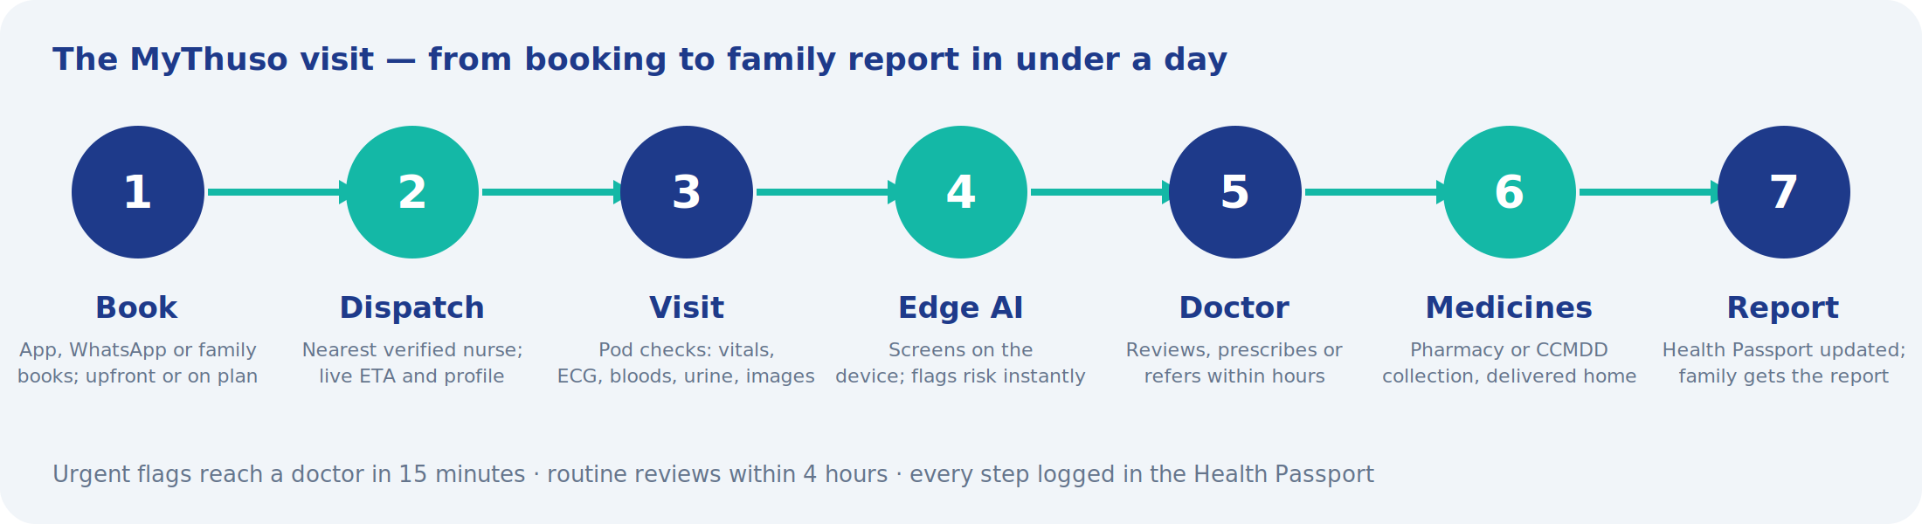




The solution
A nurse at the door in under an hour, a doctor on the screen, your record in your pocket
Dispatch marketplace
Connected diagnostic kit
AI screens, doctor decides
Health Passport
Nearest verified nurse, live ETA, fixed price, OTP completion
12 checks captured digitally on every visit
Risk flags in seconds; a registered doctor signs every result
A patient-owned record that grows with every visit
MyThuso · Help. Health. Home. · Confidential

Slide 5
MyThuso for Mom
A remittance for care — paid by the child in the city, delivered to the parent at home
Essential
Plus
Premium
R399
R749
R1,299
per month
per month
per month
Monthly nurse visit · medicine collected and delivered · WhatsApp report and photo after every visit
Fortnightly visits · doctor review of every visit · Thuso Band with SOS · one urgent call-out · quarterly screening
Weekly visits · Thuso Home video station · pill dispenser · carer hours · priority SOS · family dashboard
Same nurse every visit · CCMDD and pharmacy collection · siblings split the bill · sold at taxi ranks, churches, stokvels, employers and to the diaspora
MyThuso · Help. Health. Home. · Confidential

Slide 6
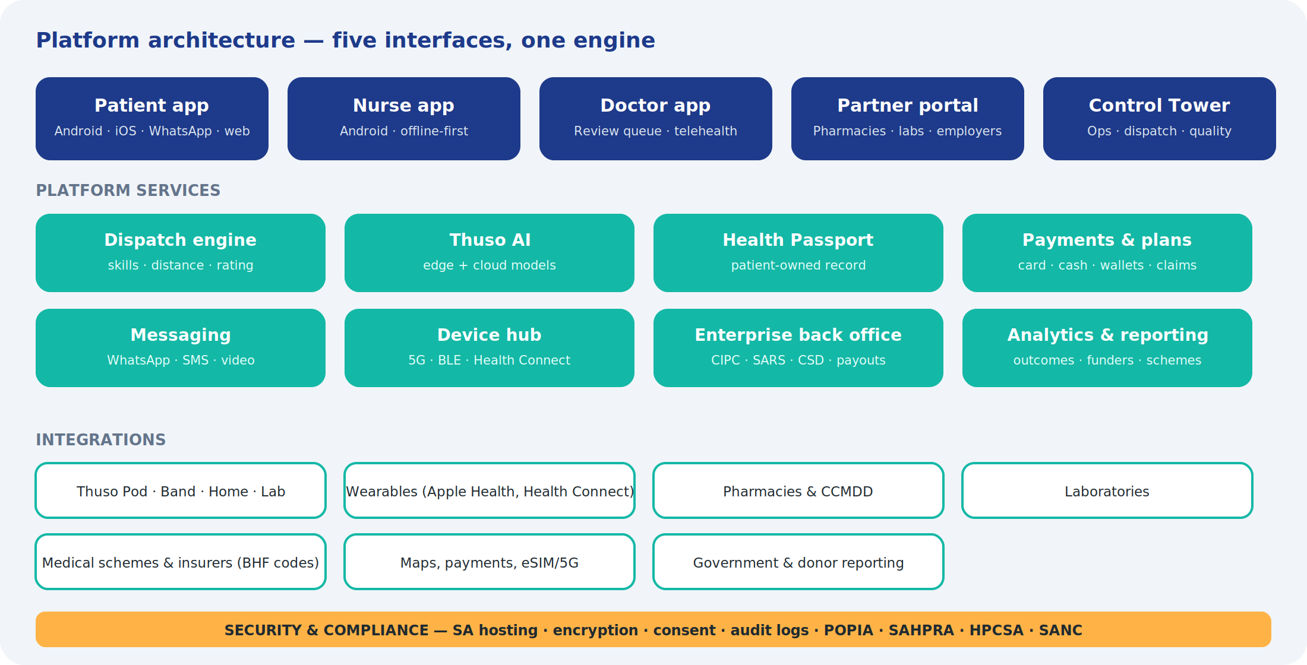
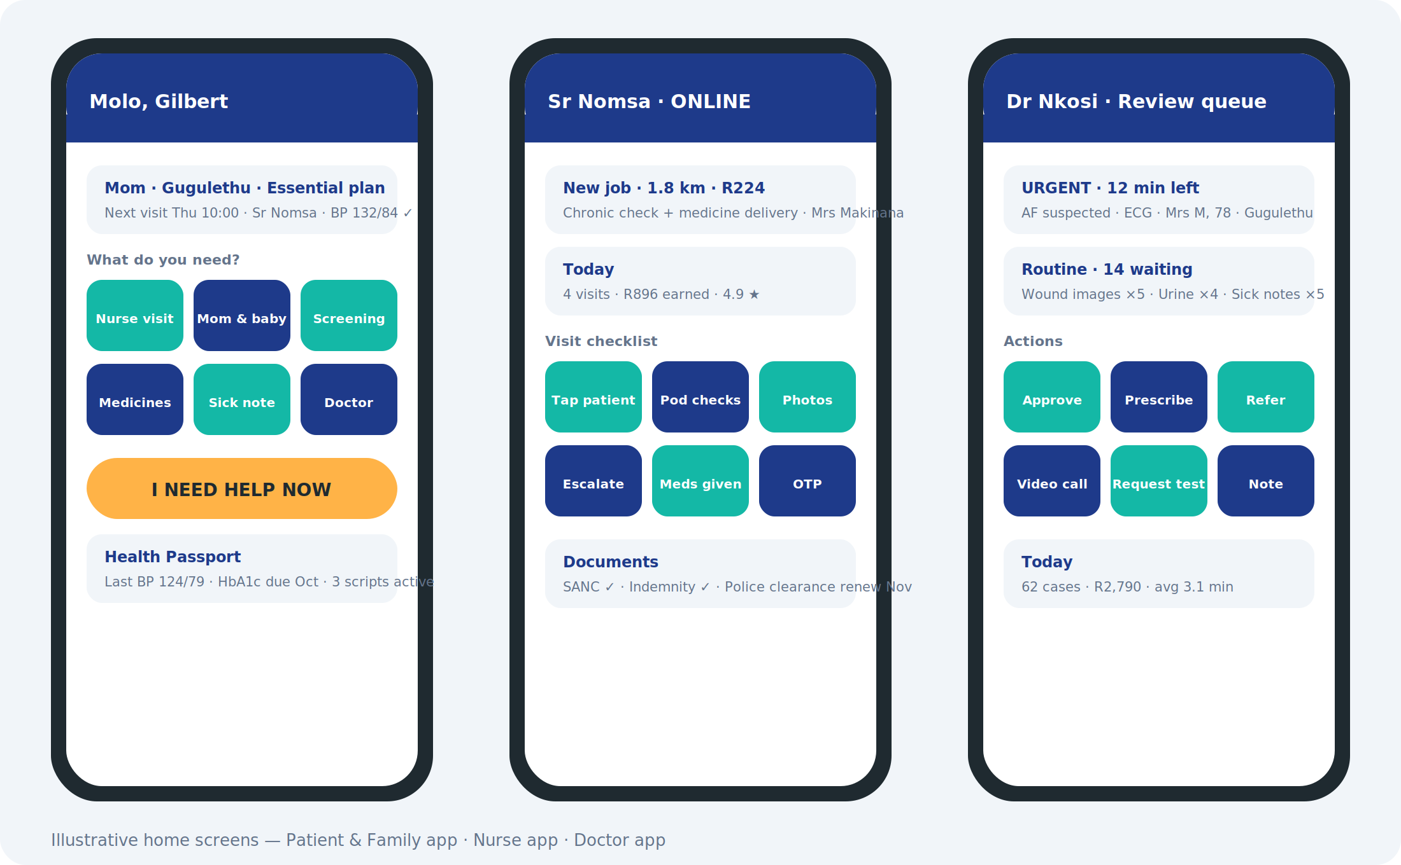
One platform, five interfaces
Patient & Family · Nurse · Doctor · Partners · Control Tower
Offline-first nurse app · WhatsApp and USSD for families without smartphones · eleven languages · cash and card
MyThuso · Help. Health. Home. · Confidential

Slide 7





Features that make it stick
Built around how South African families actually live
USSD & voice booking
Thuso Line
Family video moments
*120# and a call line in eleven languages for parents on feature phones
Human dispatchers on phone and WhatsApp who also sell the Mom plans
A 20-second clip of Mom after every visit — the retention feature
Nurse safety suite
Medicine interaction checker
Adherence rewards
Panic button, check-in timers, trip sharing, evening escort pairing
Flags clashes across clinic, private and pharmacy scripts
Airtime and data for taking medicines and keeping visits, pharma-funded
Referral tracker
Stokvel & church admin
Public impact dashboard
Follows a hospital referral to its outcome — nobody does this today
A treasurer manages members, contributions and screening days
Live jobs, visits and diagnoses — a fundraising tool in itself
Also in the specification: load-shedding-aware scheduling · rural route optimisation · community health worker mode · emergency ICE sticker · voice-first triage · children's Road-to-Health passport

Slide 8
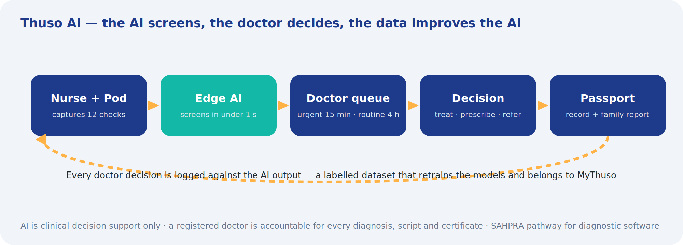
Thuso AI — the AI screens, the doctor decides
Fifteen home-captured tests, every one reviewed by a registered doctor
Vital-sign risk score
Glucose / HbA1c
Single-lead ECG (AF)
Wound imaging
Skin lesion triage
Urine strip reading
Rapid tests (HIV, syphilis, malaria)
Anaemia screening
Cough & lung sounds (TB)
Diabetic eye screening
Urgent flags reach a doctor in 15 minutes · routine reviews in 4 hours · every doctor decision trains the next model · SAHPRA pathway for diagnostic software
Antenatal ultrasound
Child growth
Adherence prediction
Triage assistant
MyThuso · Help. Health. Home. · Confidential

Slide 9
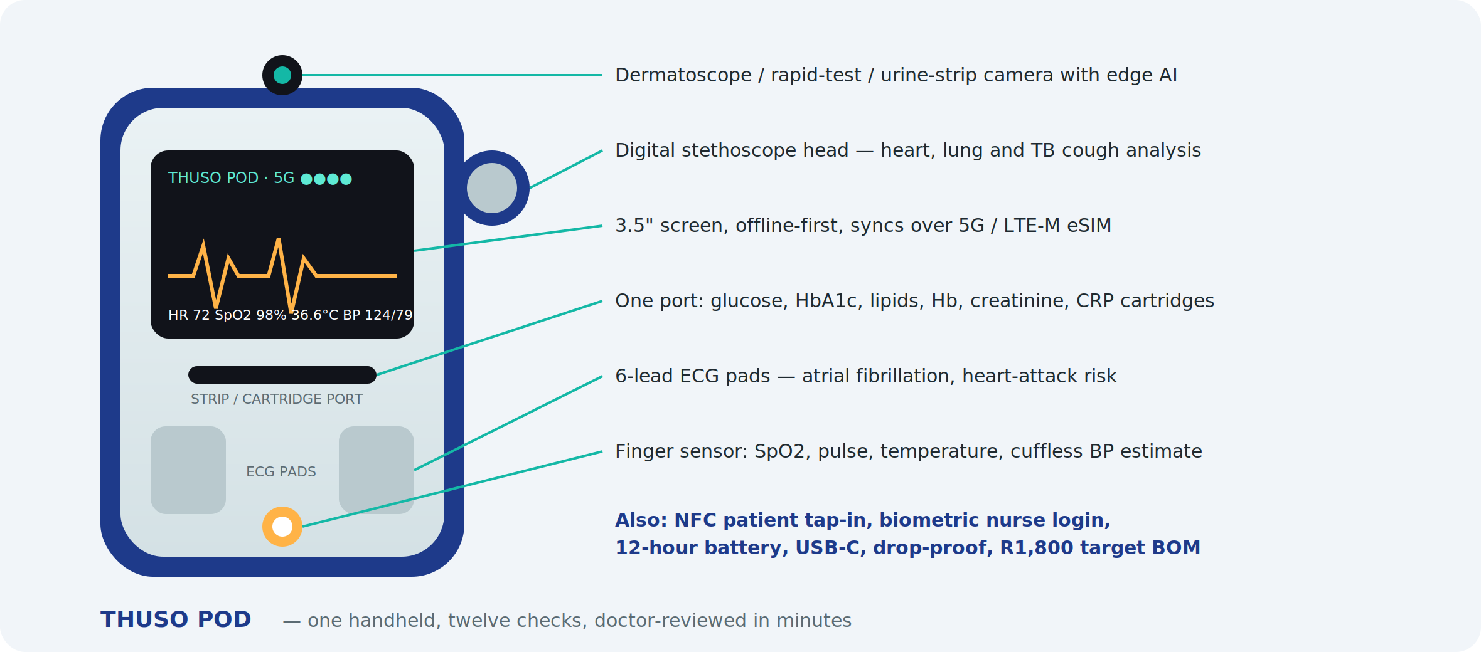
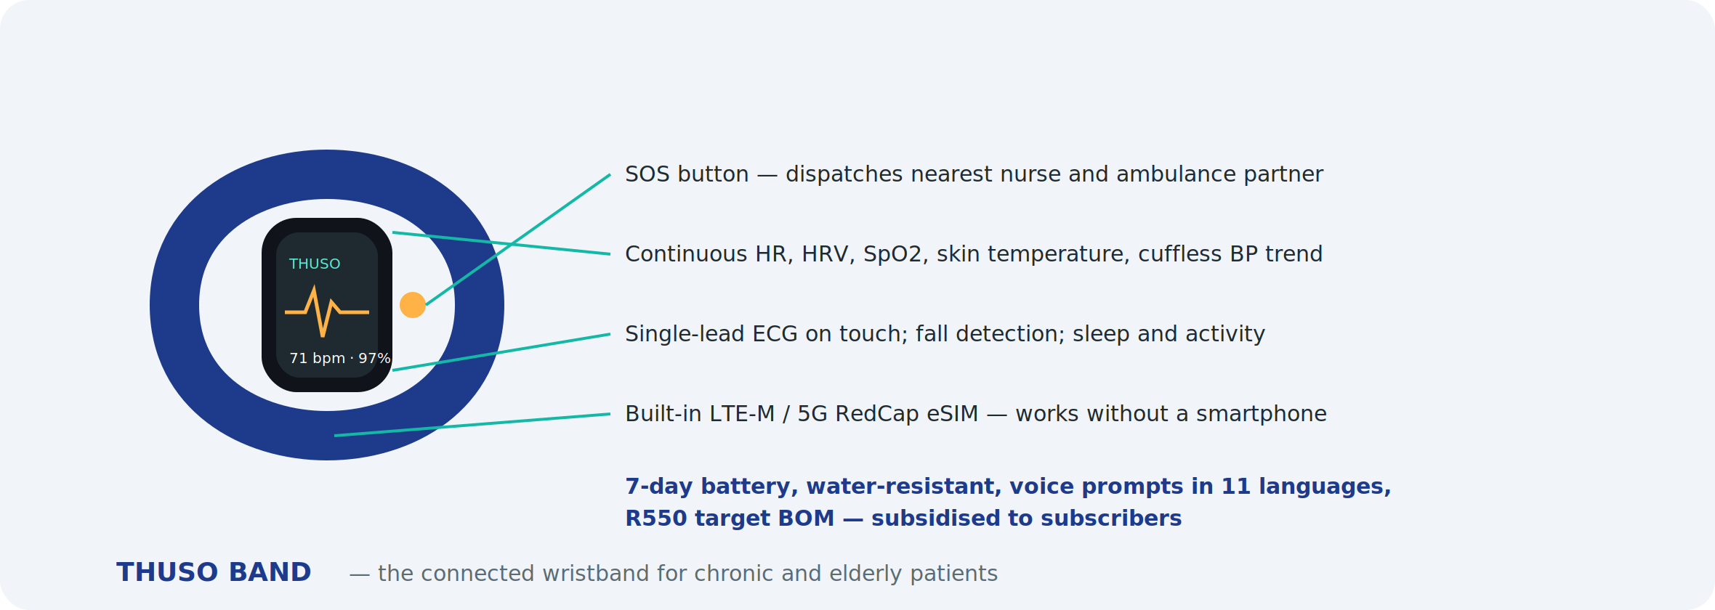
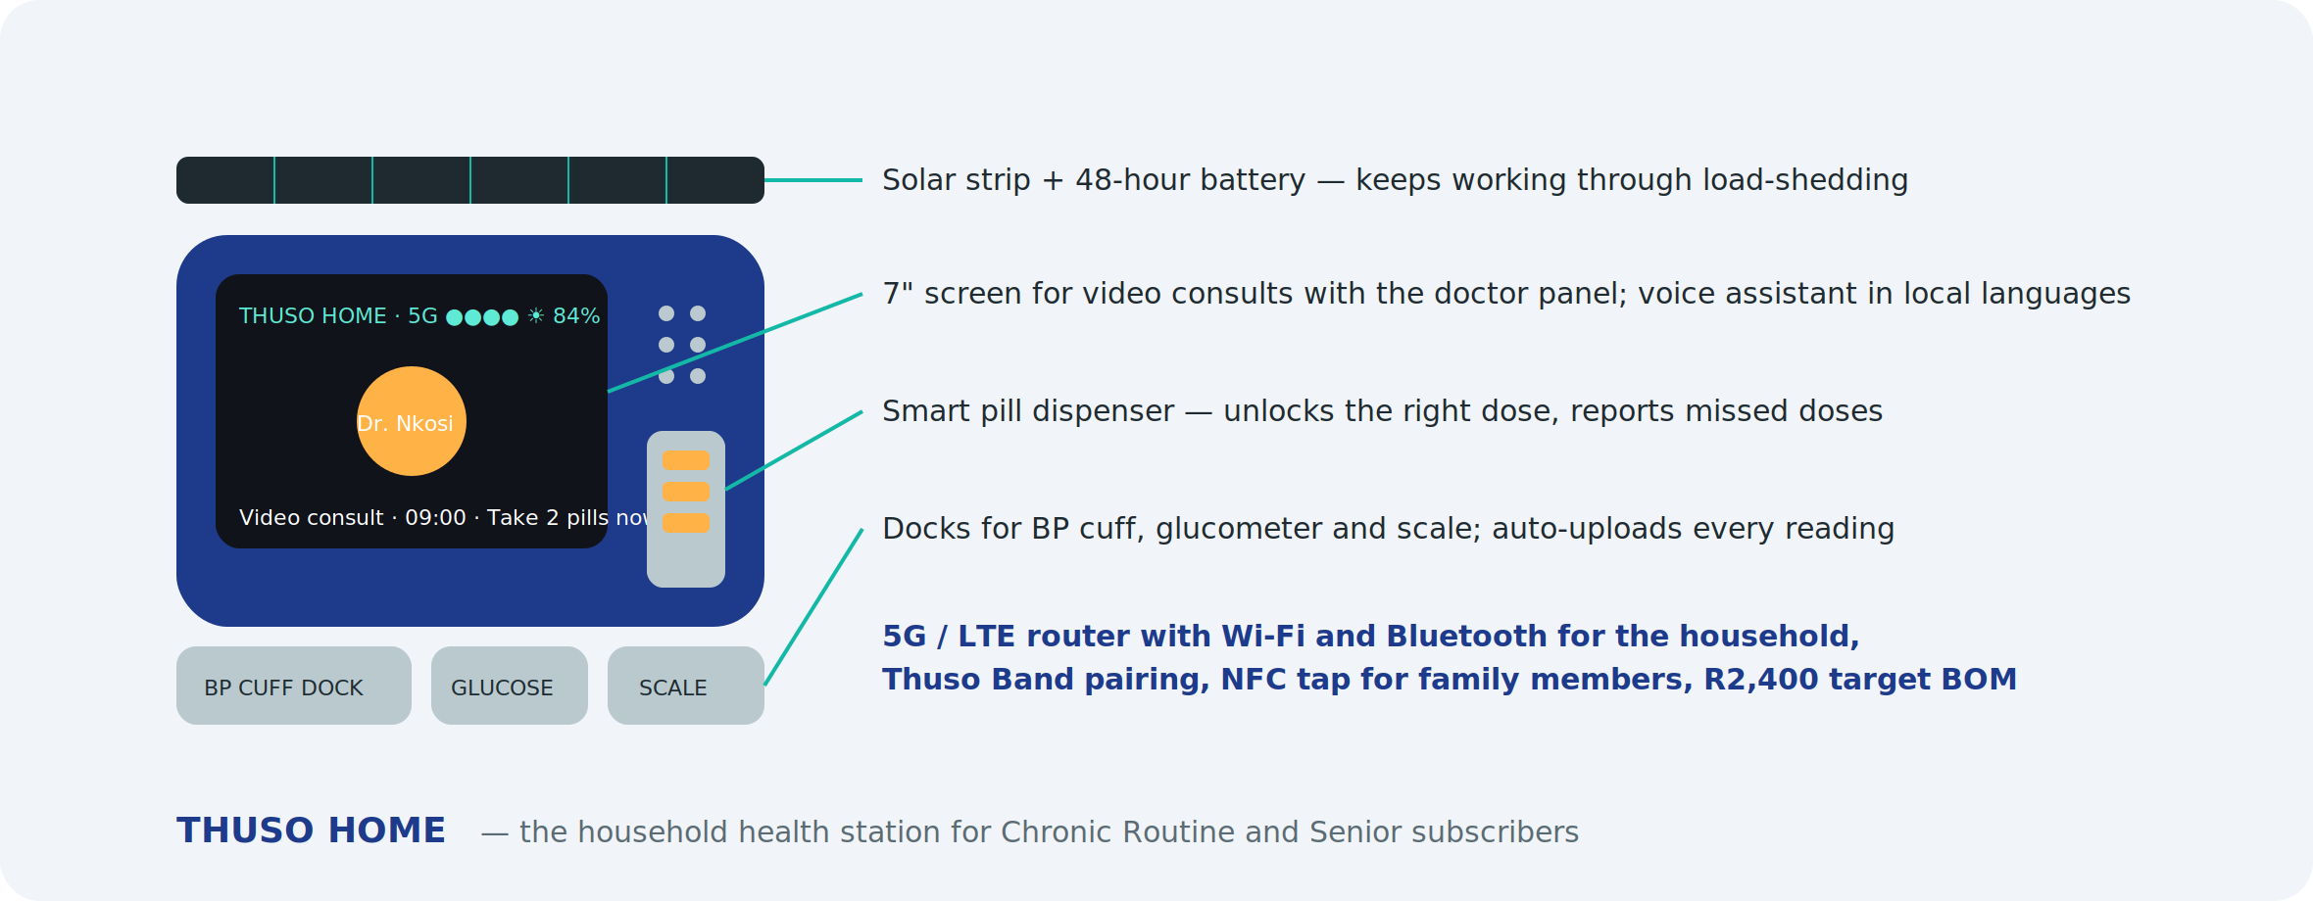
Our own 5G-connected devices
Built for South African homes: load-shedding, no data, no smartphone
Thuso Pod — one handheld, twelve checks, edge AI, 5G eSIM, NFC tap-in. R1,800 target BOM vs R8,000 of bought kit.
Thuso Band — wristband with its own eSIM, SOS button, fall detection. R550.
Thuso Home — video consults, pill dispenser, solar backup, household 5G router. R2,400.
MyThuso · Help. Health. Home. · Confidential

Slide 10
Tests and screening at home
What a clinic collects, collected in the kitchen
Urine
Stool
Mouth & saliva
Blood
10-parameter strip, pregnancy, microalbumin, drug screen → UTI, diabetes, kidney, pre-eclampsia
FIT, H. pylori, rotavirus, calprotectin → colorectal cancer, ulcers, IBD
Oral HIV, COVID/flu, strep, drug test, AI oral-cancer photo
Fingerprick glucose, HbA1c, lipids, Hb, HIV/syphilis, hep B/C, malaria, CRP, creatinine; venous to lab
Thuso Screen packages
Cervical (HPV self-sample) · Breast (exam + handheld scanner) · Colorectal · Prostate · Oral · Skin · Lung · Cardiovascular · Kidney · TB & HIV · Mental health · Cognitive · Vision & hearing · Antenatal · Occupational
Women's R699 · Men's R649 · Senior R799 · Family R999 · Worker R350–R550 · Community screens sponsored
MyThuso · Help. Health. Home. · Confidential

Slide 11



A jobs engine for nurses and doctors
Every provider is a micro-enterprise on the platform
500
300
R2.5k+
75%
nurse-entrepreneurs by month 18, keeping 75% of every visit
doctors earning from the review panel, telehealth, home visits and virtual practices
a doctor can earn per day clearing the review queue from home
of visit fees paid to the nurse, weekly, no admin
Micro-enterprise back office
Tools of trade
Earn while you learn
Safety and cover
CIPC, SARS, CSD, banking, invoicing handled by the app
Kits on rent-to-own or grant-funded; owned after 12 months
HWSETA learnerships: carer → EN → RN → Lead → Circuit owner
Group indemnity, income protection, panic button, check-in timers
MyThuso · Help. Health. Home. · Confidential

Slide 12


Who pays besides families
Pharma, schemes, employers and government fund what MyThuso produces anyway
Pharmaceutical companies
Medical schemes & insurers
Government & funders
Sponsored screening finds undiagnosed patients · Patient Support Programmes at R150–R400 per patient per month · real-world evidence · trial recruitment
Chronic capitation R120–R250 pmpm · hospital-at-home and post-discharge · low-cost benefit options · wellness and screening
HWSETA, UIF LAP, Jobs Fund, YES, NYDA, DSBD/sefa, ESD, TIA, DSD home-care subsidies, DoH outreach contracts
Aspen · Adcock · Cipla · Sanofi · Novartis · Novo Nordisk · Abbott · Roche
Dis-Chem Health · Kaelo · Bonitas · Medihelp · Discovery · GEMS (tender)
R2m–R5m non-equity co-funding in 18 months
MyThuso · Help. Health. Home. · Confidential

Slide 13
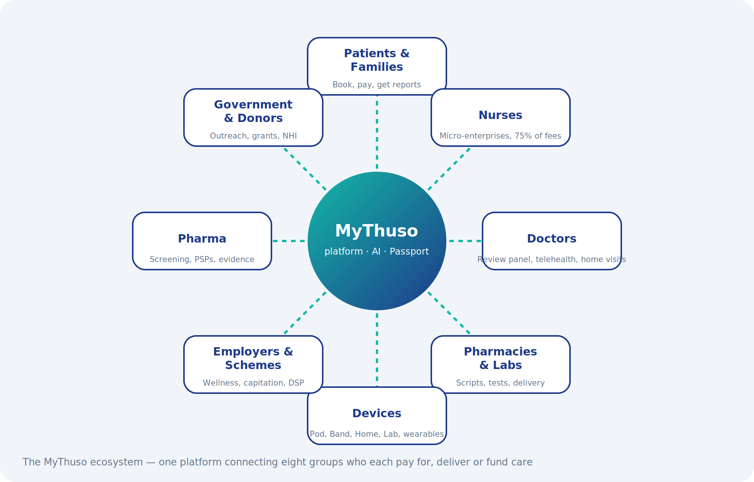
The market
Big, underserved, and already paying for on-demand
50m
15m+
1m+
2m+
South Africans without medical aid who depend on public clinics
people living with hypertension, diabetes, HIV or TB needing monthly care
births a year; a fast-growing elderly population
GEMS beneficiaries alone, procured by tender
Launch: Soweto, Roodepoort/Randburg, Tembisa
Then Pretoria and Ekurhuleni, Cape Town starting in Gugulethu, and rural Circuits along the corridors Johannesburg's workforce comes from: Limpopo, Eastern Cape, KZN, North West.
MyThuso · Help. Health. Home. · Confidential

Slide 14
Business model
Eleven revenue streams — no single stream above a third
Unit economics
R299 visit → nurse R224 → fees R9 → MyThuso R66
Mom plans: R80–R400 retained per parent per month
Doctor review paid per case from bundles and plans
Month 9: 100 visits/day, 2,000 subs → break-even
Month 15: 300 visits/day, 6,000 subs → R1.15m/month
Year 3: 1,000 visits/day, 3 cities → R4m/month
MyThuso · Help. Health. Home. · Confidential

Slide 15
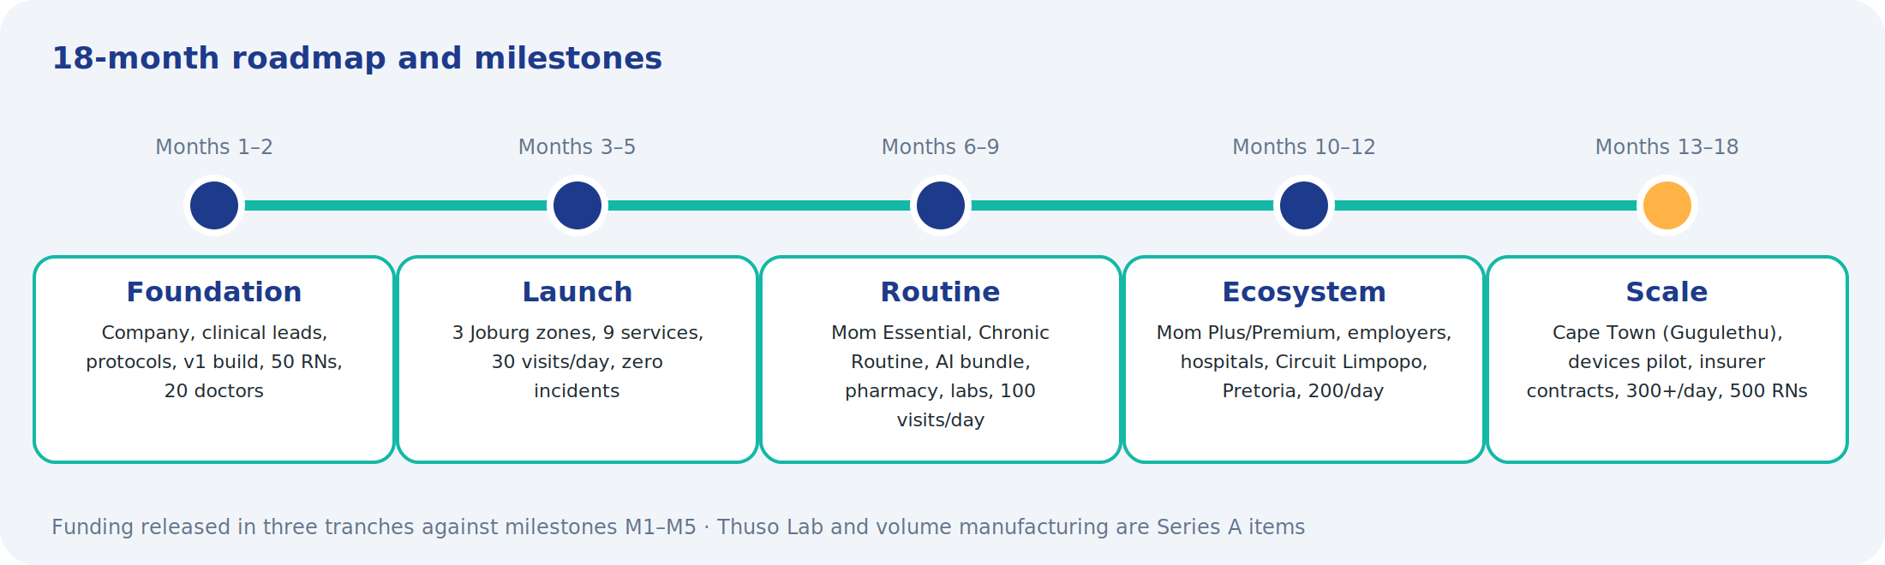
Eighteen months to a national platform
Funding released in three tranches against five milestones
M1 · 50 RNs, v1 live, 20 doctors
M2 · 500 visits, zero incidents
M3 · 100/day, 2,000 subs, AI bundle
M4 · 200/day, first insurer & pharma contracts
M5 · 300/day, 500 RNs, Cape Town, device pilot
MyThuso · Help. Health. Home. · Confidential

Slide 16
The ask: R9.7 million seed
Plus R2m–R5m in grant and enterprise-development co-funding
Tranche 1 · R3.0m
Foundation and launch: M1–M2
Tranche 2 · R3.9m
Routine and ecosystem: M3–M4
Tranche 3 · R2.8m
Scale and devices: M5
Thuso Lab and volume manufacturing are Series A items · natural Series A partners: insurers, pharmacy groups, hospital groups, impact funds
MyThuso · Help. Health. Home. · Confidential

Slide 17
Impact in 18 months
What we will be able to say to a Minister, a funder and a family
800 health micro-enterprises
Earlier diagnosis
Decongested clinics
nurses, doctors and carers, most previously unemployed
cancer, hypertension, diabetes, kidney, TB, HIV caught at home
routine tasks moved out of public queues; fewer readmissions
Rural reach
A data layer
NHI-ready infrastructure
pensioners in villages cared for, paid for by their children
outcomes by area for schemes, pharma and provincial planning
a contractable community primary-care network
MyThuso · Help. Health. Home. · Confidential

Slide 18
Team and next steps
Gilbert Makinana
Clinical Governance Lead
Founder & CEO · software entrepreneur · Director, Akhanya IT Innovations (Level 1 B-BBEE)
Senior RN, 10+ years · protocols, vetting, incidents · appointed at funding
Medical Director
Akhanya development team
HPCSA doctor · doctor panel and AI governance · appointed at funding
Builds and operates the platform
Next 90 days
Register MyThuso and the NPO · appoint Clinical Lead and Medical Director · 50 RNs and 20 doctors · one pharmacy, one lab · v1 live · pilot in Soweto, Roodepoort and Tembisa
gilbert@akhanya.co.za · +27 79 077 1591
MyThuso · Help. Health. Home. · Confidential

